Slide 1
Flipkart Review Sentiments Analysis
Khushi Srivastava(Code&Data)
Ishika Saxena(PPT&Report)

Slide 2
Introduction
Objective:
To analyze Flipkart reviews using sentiment analysis techniques to classify customer feedback as positive, negative, or neutral.
Importance:
Helps Flipkart improve customer satisfaction.
Provides insights into products, services, and customer experience.

Slide 3

Problem statement
Flipkart receives a large volume of customer reviews.
It is challenging to manually analyze and classify sentiments from these reviews.
Aim: Automate sentiment analysis using AI to gain real-time insights.

Slide 4
Dataset
Source:
Flipkart reviews dataset:
C:\Users\ishik\Downloads\flipkart_data.csv
Number of features: In your code, you're using at least 3 features:
Review text
Rating
Sentiment
An estimated value of features may vary from 3 – 6 depending upon the datatype
Data Size: Number of rows 10,000 to 50,000 rows., features.
Preprocessing: Cleaning and preparing data for analysis (handling missing values, text cleaning)

Slide 5
Sentiment Analysis Techniques
Text Preprocessing: Tokenization, stop-word removal,lemmatization
nltk.download('stopwords')
nltk.download('punkt')
nltk.download('wordnet')
stop_words =
set(stopwords.words('english'))
lemmatizer = WordNetLemmatizer()
def preprocess_text(text):
# Lowercasing
text = text.lower()

Slide 6
# Tokenization
words = nltk.word_tokenize(text)
# Remove stopwords and lemmatization
words = [lemmatizer.lemmatize(word) for word in
words if word.isalnum() and word not in
stop_words]
return ' '.join(words)

Slide 7
Tools and Technologies
Programming Languages: Python
Libraries:
Pandas (for data manipulation)
Numpy (for numerical operations)
Scikit-learn (for machine learning models)
NLTK/Spacy (for natural language processing)
Environment: VS Code

Slide 8
Methodology
Step 1: Load and explore the dataset.
Step 2: Clean the review text (remove punctuation, stop words, etc.).
Step 3: Feature extraction.
Step 4: Train machine learning or deep learning models.
Step 5: Evaluate the models using test data.

Slide 9
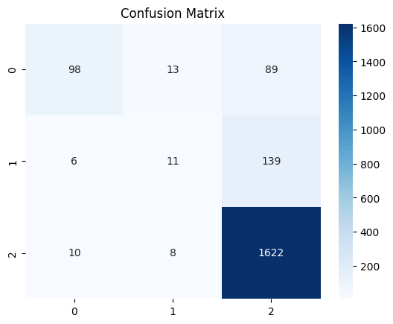
Model Evaluation
Display results of model accuracy and other evaluation metrics.
model = LogisticRegression()
model.fit(X_train, y_train)
y_pred = model.predict(X_test)
Confusion Matrix: To show true positives, false positives, etc.

Slide 10
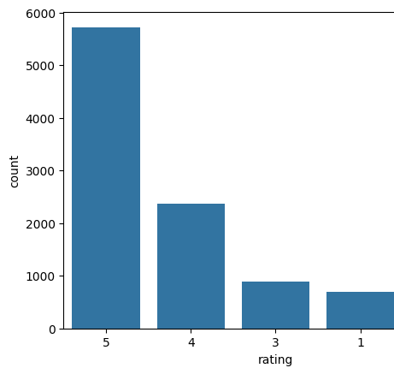
Results
Sentiment Distribution: Pie chart or bar graph showing the proportion of positive, negative, and neutral reviews.

Slide 11
Conclusion
Summary:
We successfully built an AI model to classify Flipkart reviews based on sentiment.
The model has shown good accuracy and can be deployed for automated review analysis.
Impact: Helps Flipkart enhance its services based on customer feedback.

